Slide 1
Chapter 5
More SQL: Complex Queries, Triggers, Views, and Schema Modification

Slide 2
Chapter 5 Outline
More Complex SQL Retrieval Queries
Specifying Constraints as Assertions and Actions as Triggers
Views (Virtual Tables) in SQL
Schema Change Statements in SQL

Slide 3
More Complex SQL Retrieval Queries
Additional features allow users to specify more complex retrievals from database:
  Nested queries, joined tables, outer joins, aggregate functions, and grouping

Slide 4
Comparisons Involving NULL and Three-Valued Logic
Meanings of NULL
  Unknown value
  Unavailable or withheld value
  Not applicable attribute
Each individual NULL value considered to be different from every other NULL value
SQL uses a three-valued logic:
  TRUE, FALSE, and UNKNOWN

Slide 5
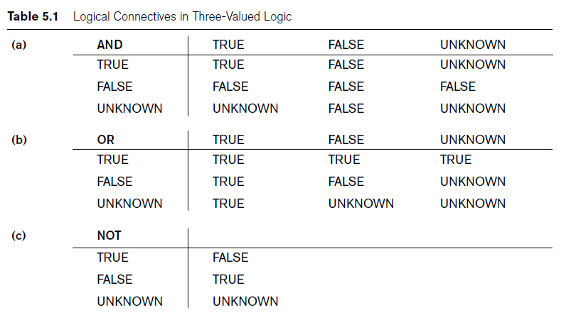
Comparisons Involving NULL and Three-Valued Logic (cont’d.)
Notes:
Logical Connectives in 3-Valued Logic

Slide 6

Comparisons Involving NULL and Three-Valued Logic (cont’d.)
SQL allows queries that check whether an attribute value is NULL
  IS or IS NOT NULL

Slide 7
Nested Queries, Tuples, and Set/Multiset Comparisons
Nested queries
  Complete select-from-where blocks within WHERE clause of another query
  Outer query
Comparison operator IN
  Compares value v with a set (or multiset) of values V
  Evaluates to TRUE if v is one of the elements in V

Slide 8

Nested Queries (cont’d.)
Notes:
The IN operator is a shorthand for multiple OR conditions.

Slide 9

Nested Queries (cont’d.)
Use tuples of values in comparisons
  Place them within parentheses

Slide 10

Nested Queries (cont’d.)
Use other comparison operators to compare a single value v
  = ANY (or = SOME) operator
    Returns TRUE if the value v is equal to some value in the set V and is hence equivalent to IN
  Other operators that can be combined with ANY (or SOME): >, >=, <, <=, and <>
Notes:
The ALL operator returns true if all of the subquery values meet the condition.
The ANY (or some) operator returns true if any of the subquery values meet the condition.

Slide 11

Nested Queries (cont’d.)
Avoid potential errors and ambiguities
  Create tuple variables (aliases) for all tables referenced in SQL query
Notes:
The name of each employee who has a dependent with the same first name and is the same sex as the employee

Slide 12
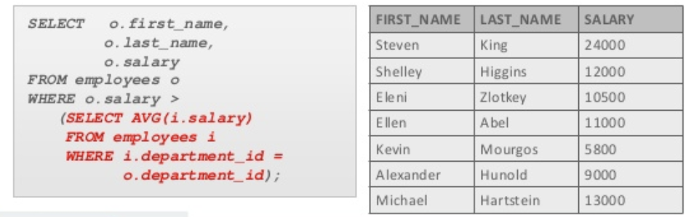
Correlated Nested Queries
Correlated nested query
  Each subquery is executed once for every row of the outer query
  With a normal subquery, the inner SELECT query runs first and executes once, returning values to be used by the outer query.

Slide 13
The EXISTS and UNIQUE Functions in SQL
EXISTS function
  The EXISTS operator is used to test for the existence of any record in a subquery.
EXISTS and NOT EXISTS
  Typically used in conjunction with a correlated nested query
SQL function UNIQUE(Q)
  Returns TRUE if there are no duplicate tuples in the result of query Q

Slide 14

Explicit Sets and Renaming of Attributes in SQL
Can use explicit set of values in WHERE clause
Use qualifier AS followed by desired new name
  Rename any attribute that appears in the result of a query

Slide 15

Joined Tables in SQL and Outer Joins
Joined table
  Permits users to specify a table resulting from a join operation in the FROM clause of a query
The FROM clause in Q1A
  Contains a single joined table
Notes:
The reason here we used join, because we wanted to write the Department Name and we want to read from EMPLOYEE. In the EMPLOYEE table, there is no name.

Slide 16
Joined Tables in SQL and Outer Joins (cont’d.)
Specify different types of join
  NATURAL JOIN
  Various types of OUTER JOIN
NATURAL JOIN on two relations R and S
  No join condition specified
  Implicit EQUIJOIN condition for each pair of attributes with same name from R and S
Notes:
NAUTRAL JOIN doesn’t need any join condition and it uses the same name (column names) in both tables. In Inner Join we need to specify the join condition.
An equijoin is a join with a join condition containing an equality operator.

Slide 17
Joined Tables in SQL and Outer Joins (cont’d.)
Inner join
  Default type of join in a joined table
  Tuple is included in the result only if a matching tuple exists in the other relation
LEFT OUTER JOIN
  Every tuple in left table must appear in result
  If no matching tuple
    Padded with NULL values for attributes of right table

Slide 18
Joined Tables in SQL and Outer Joins (cont’d.)
RIGHT OUTER JOIN
  Every tuple in right table must appear in result
  If no matching tuple
    Padded with NULL values for the attributes of left table
FULL OUTER JOIN
Can nest join specifications
Notes:
MySQL doesn’t have FULL JOINS, but we can emulate it by using UNION, LEFT JOIN and RIGHT JOIN
SELECT * FROM t1 LEFT JOIN t2 ON t1.id = t2.id
UNION
SELECT * FROM t1 RIGHT JOIN t2 ON t1.id = t2.id

Slide 19
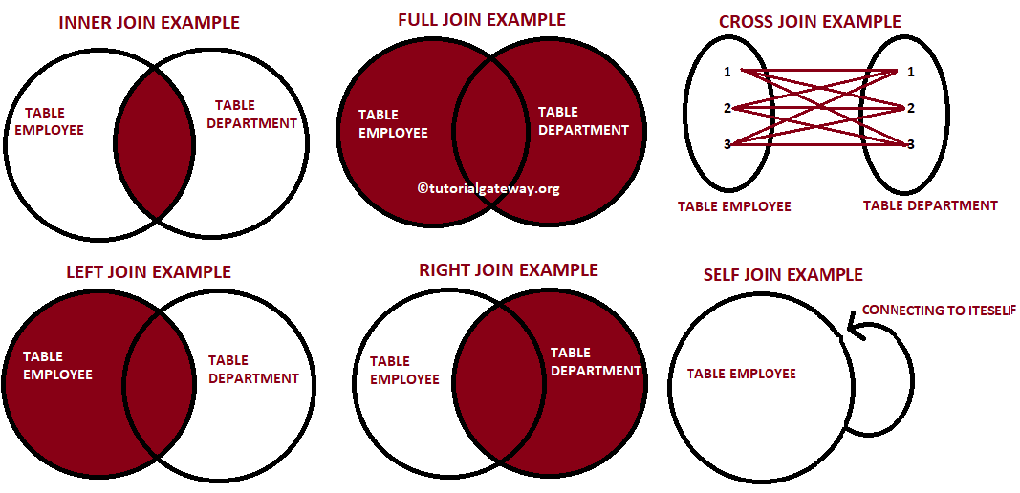
Joined Tables in SQL and Outer Joins (cont’d.)

Slide 20
Aggregate Functions in SQL
Aggregate Functions are used to summarize information from multiple tuples into a single-tuple summary
Grouping
  Create subgroups of tuples before summarizing
Built-in aggregate functions
  COUNT, SUM, MAX, MIN, and AVG
Functions can be used in the SELECT clause or in a HAVING clause

Slide 21

Aggregate Functions in SQL (cont’d.)
NULL values discarded when aggregate functions are applied to a particular column

Slide 22
Grouping: The GROUP BY and HAVING Clauses
Partition relation into subsets of tuples
  Based on grouping attribute(s)
  Apply function to each such group independently
GROUP BY clause
  Specifies grouping attributes
If NULLs exist in grouping attribute
  Separate group created for all tuples with a NULL value in grouping attribute

Slide 23
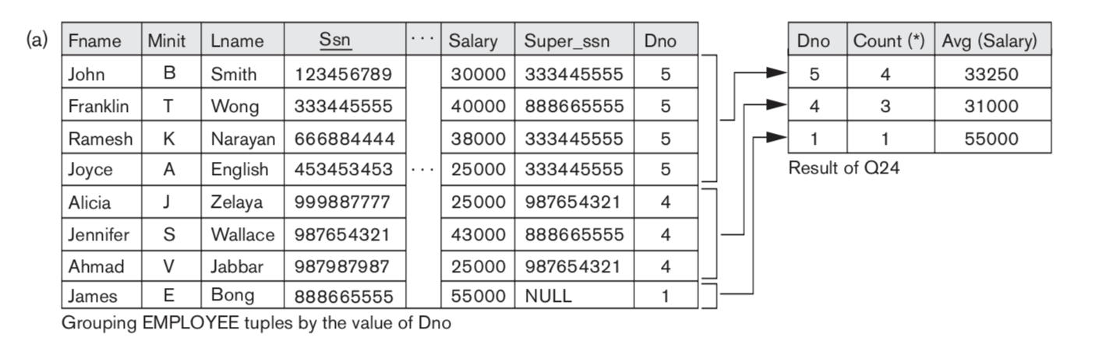
Grouping: The GROUP BY and HAVING Clauses (cont’d.)
SELECT Dno, COUNT (*), AVG (Salary)
FROM EMPLOYEE
GROUP BY Dno;

Slide 24

Grouping: The GROUP BY and HAVING Clauses (cont’d.)
HAVING clause
  Provides a condition on the summary information

Slide 25

Discussion and Summary of SQL Queries

Slide 26
Specifying Constraints as Assertions and Actions as Triggers
CREATE ASSERTION
  Specify additional types of constraints outside scope of built-in relational model constraints
CREATE TRIGGER
  Specify automatic actions that database system will perform when certain events and conditions occur

Slide 27

Specifying General Constraints as Assertions in SQL
CREATE ASSERTION
  Specify a query that selects any tuples that violate the desired condition
  Use only in cases where it is not possible to use CHECK on attributes and domains

Slide 28
Introduction to Triggers in SQL
A trigger is a special kind of stored procedure that automatically executes when an event occurs in the database server
CREATE TRIGGER statement
  Used to monitor the database
Typical trigger has three components:
  Event(s)
  Condition
  Action

Slide 29
Introduction to Triggers in SQL
For example, it may be useful to specify a condition that, if violated, causes some user to be informed of the violation. A manager may want to be informed if an employee’s travel expenses exceed a certain limit by receiving a message whenever this occurs.

Slide 30
Views (Virtual Tables) in SQL
Concept of a view in SQL
  Single table derived from other tables
  Considered to be a virtual table

Slide 31

Specification of Views in SQL
CREATE VIEW command
  Give table name, list of attribute names, and a query to specify the contents of the view

Slide 32
Specification of Views in SQL (cont’d.)
Specify SQL queries on a view
View always up-to-date
  Responsibility of the DBMS and not the user
DROP VIEW command
  Dispose of a view

Slide 33
Schema Change Statements in SQL
Schema evolution commands
  Can be done while the database is operational
  Does not require recompilation of the database schema

Slide 34
The DROP Command
DROP command
  Used to drop named schema elements, such as tables, domains, or constraint
Example:
  DROP DATABASE <database_name>;
  DROP TABLE <table_name>;
  Options: CASCADE or RESTRICT
Note : You should be very careful while using this command because once a database or table is deleted then all the information available in that database or table will also be lost forever
Notes:
CASCADE: drop all referential integrity constraints that refer to primary and unique keys in the dropped table
RESTRICT : rejects if there is any dependencies.

Slide 35
The ALTER Command
Alter table actions include:
  Adding or dropping a column (attribute)
  Changing a column definition
  Adding or dropping table constraints
Example:
  ALTER TABLE COMPANY.EMPLOYEE ADD COLUMN Job VARCHAR(12);
To drop a column
  Choose either CASCADE or RESTRICT

Slide 36
The ALTER Command (cont’d.)
CASCADE and RESTRICT are optional.
  default is CASCADE.
CASCADE: the column drop should additionally drop other schema objects which have become invalid (trigger, primary key, etc.). In other words, drop the dependencies first, then the main object.
RESTRICT: the column drop will be rejected if it would cause a dependent schema object to become invalid (trigger, primary key, etc.)

Slide 37

The ALTER Command (cont’d.)
Change constraints specified on a table
  Add or drop a named constraint

Slide 38
Summary
Complex SQL:
  Nested queries, joined tables, outer joins, aggregate functions, grouping
CREATE ASSERTION and CREATE TRIGGER
Views
  Virtual or derived tables

